Slide 1
INTRODUCTION TO CONIC AND ITS PARTS
INTRODUCTION OF EACH AND EVERY PARTS.
EXAMPLE QUESTION WITH SOLUTION
PRACTICE HOMEWORKS QUESTIONS

Slide 2
INTRODUCTION TO CONIC AND ITS PARTS
SPEAKER:
TOPICS:
ABDUL WASI
MOHIUDDIN
ABDUL MOIZ
SHAHEER KHAN
PARABOLA
CIRCLE
ELLIPSE
HYPERBOLA

Slide 3
PARABOLA

Slide 4
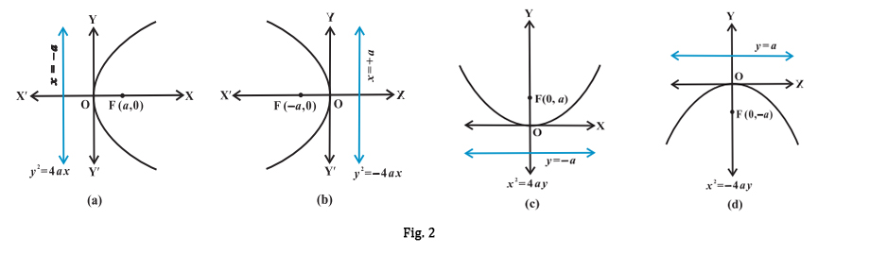
PARABOLA:-
DEFINITION:-
Parabola is a locus of a point p(x,y) which moves such that it's distance from the fixed point is same as that of its distance from the fixed line.

Slide 5
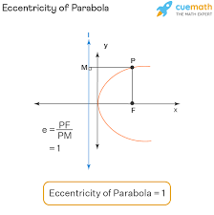
ECCENTRICITY:-
DEFINITION:-
Ratio between distance of point to focus and distance of point to directrix is called eccentricity.PF/PL=1.

Slide 6
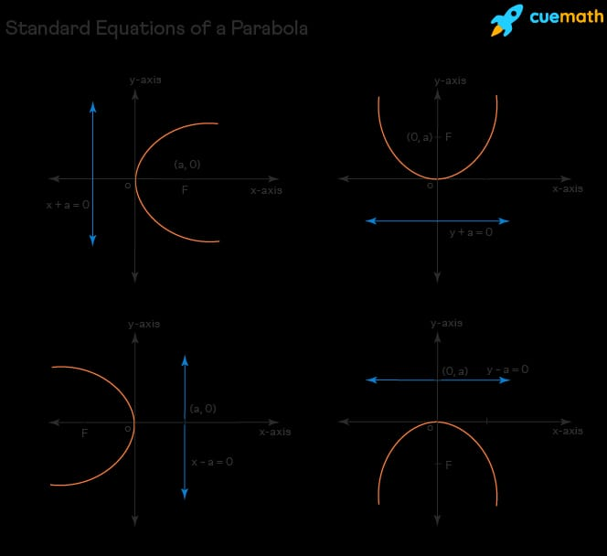
STANDARD PARABOLA:-
POINTS:-
A parabola whose focus is at (a,0)and directrix is x+a=0.Note:Vertex is at origin.
Focus of standard parabola is=(a,0)Directrix of standard parabola is (x+a)=0.

Slide 7
QUESTION:-
CONSIDER THE PARABOLA (y^2=2x),find its focus and directrix.
SOLUTION:-
Y^2=2x
Y^2=4ax
4a=2
a=1/2
Focus→(a,0)(-a,0)→(1/2,0)(-1/2,0)
Vertex→(0,0)
Directrix→x=-a→x=-1/2

Slide 8
PRACTICE QUESTION:-
QUESTION NO 01:-
FIND THE VERTEX,FOCUS,LENGTH MAJOR AXIX AND MINOR AXIS,ECCENTRICITY,LACTUS RECTUM OF THE FOLLOWING EQUATION:-
y^2=8ax
X^2=32ax
Y^2-36ax=0
-49ax=-x^2

Slide 9
CIRCLE

Slide 10
CIRCLE:
Circle is a round shaped figure that has no edge of corners.
The shape or object which has 360 degree is called circle.
DEFINITION:
As we know that circle is a round figure whose boundary (the circumference) consists of points equidistant From a fixed point (the center)
PROPERTIES:
There are three main properties of circle:
1. CIRCUMFERENCE:The circumference is the distance around the outer edge of a circle.
2. DIAMETER: A straight line passing from side to side through the centre of a body or figure, especially a circle or sphere.
3. RADIUS:The radius is the distance from the center of a circle to any point on its edge.

Slide 11
POINTS:-
WHAT IS CHORD AND TANGENT LINE?
1. CHORD: Chord is a line segment that connects two points on a curve.
2. TANGENT: A tangent line is a line that touches a curve at a single point.
FORMULA’S OF CIRCLE:
1. Area: A = π × r2
2. Circumference Of Circle: C = 2 × π × r
3. Diameter: D = 2r
4. Radius: r=d/2

Slide 12
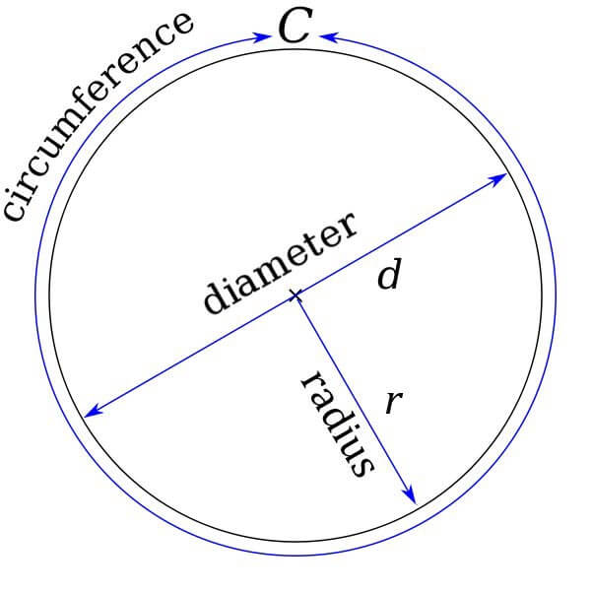
QUESTION:-
GENERAL EQUATION OF A CIRCLE: (x – h)2 + (y – k)2 = r2
Given center: (h, k) = (3, -2)
Given radius: r = 5
· (x - 3)^2 + (y - (-2))^2 = 5^2
· (x - 3)^2 + (y + 2)^2 = 25
· x^2 - 6x + 9 + y^2 + 4y + 4 = 25
· x^2 + y^2 - 6x + 4y + 13 = 25
· x^2 + y^2 - 6x + 4y - 12 = 0
· x^2 + y^2 - 6x + 4y - 12 = 0
This equation represents all the points that are 5 units away from the center (3, -2), forming a circle with the given properties.

Slide 13
ellipse

Slide 14
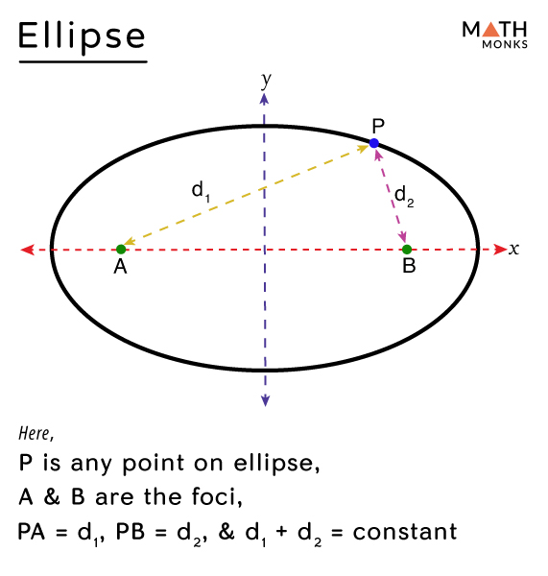
ELLIPSE
ELLIPSE:
An ellipse is the set of all points in a plane such that the sum of the distances from two fixed points (foci) is constant. An ellipse can be formed by intersecting a cone with a plane that is not parallel to the base or the apex of the cone..

Slide 15
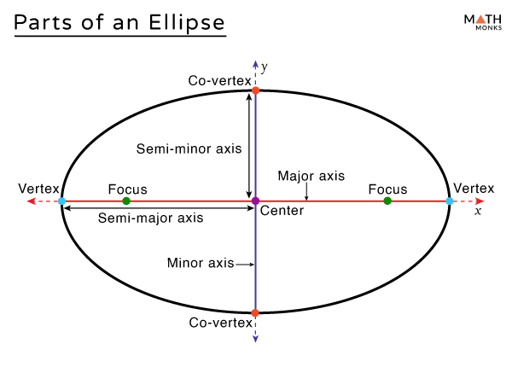
PARTS OF ELLIPSE

Slide 16
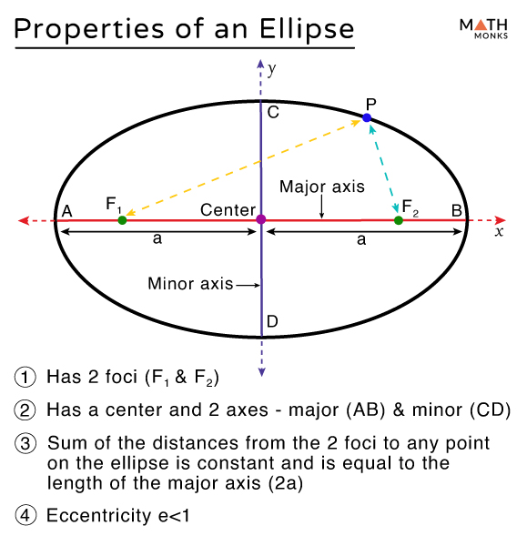
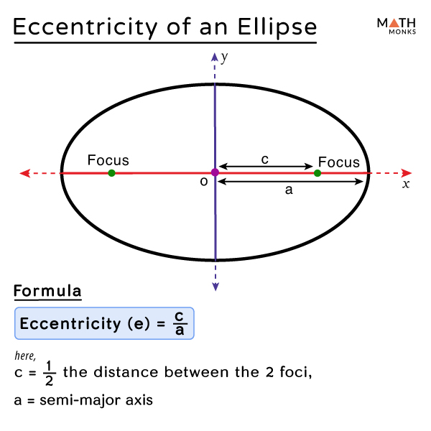

Slide 17
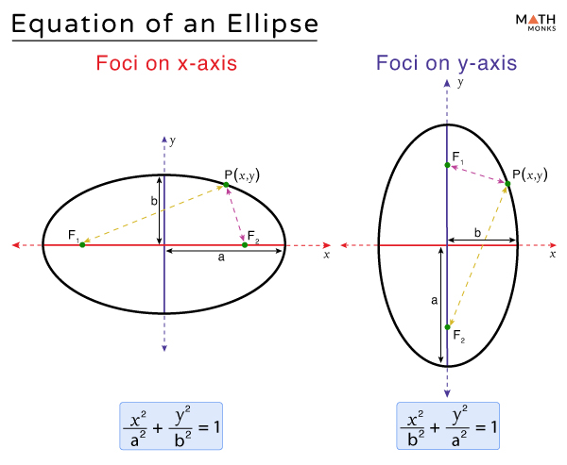

Slide 18
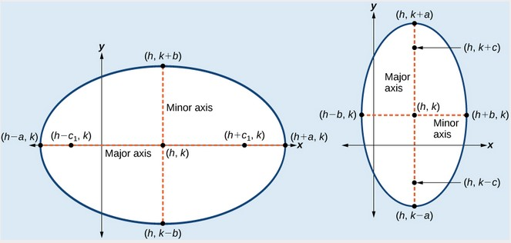
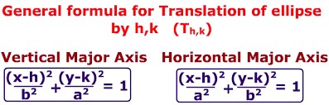

EQUATION OF AN ELLIPSE (NOT AT ORIGIN)

Slide 19
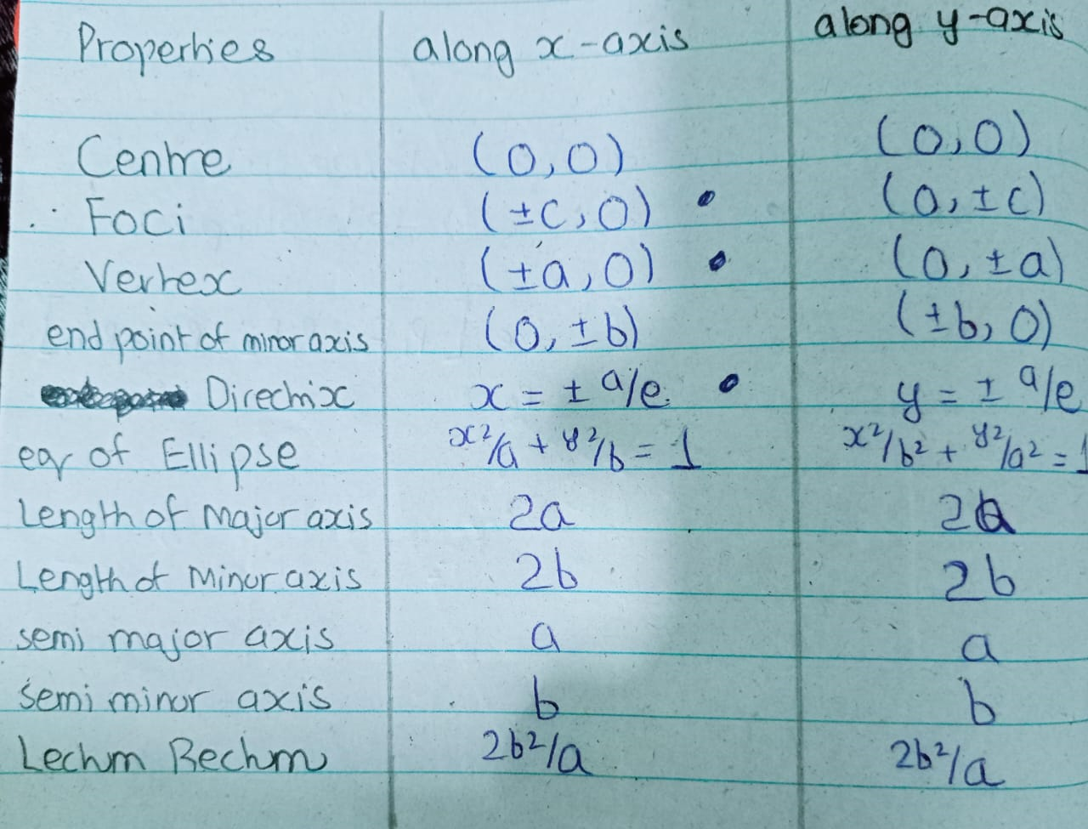
ELLIPSE WHOSE CENTRE AT ORIGIN:

Slide 20
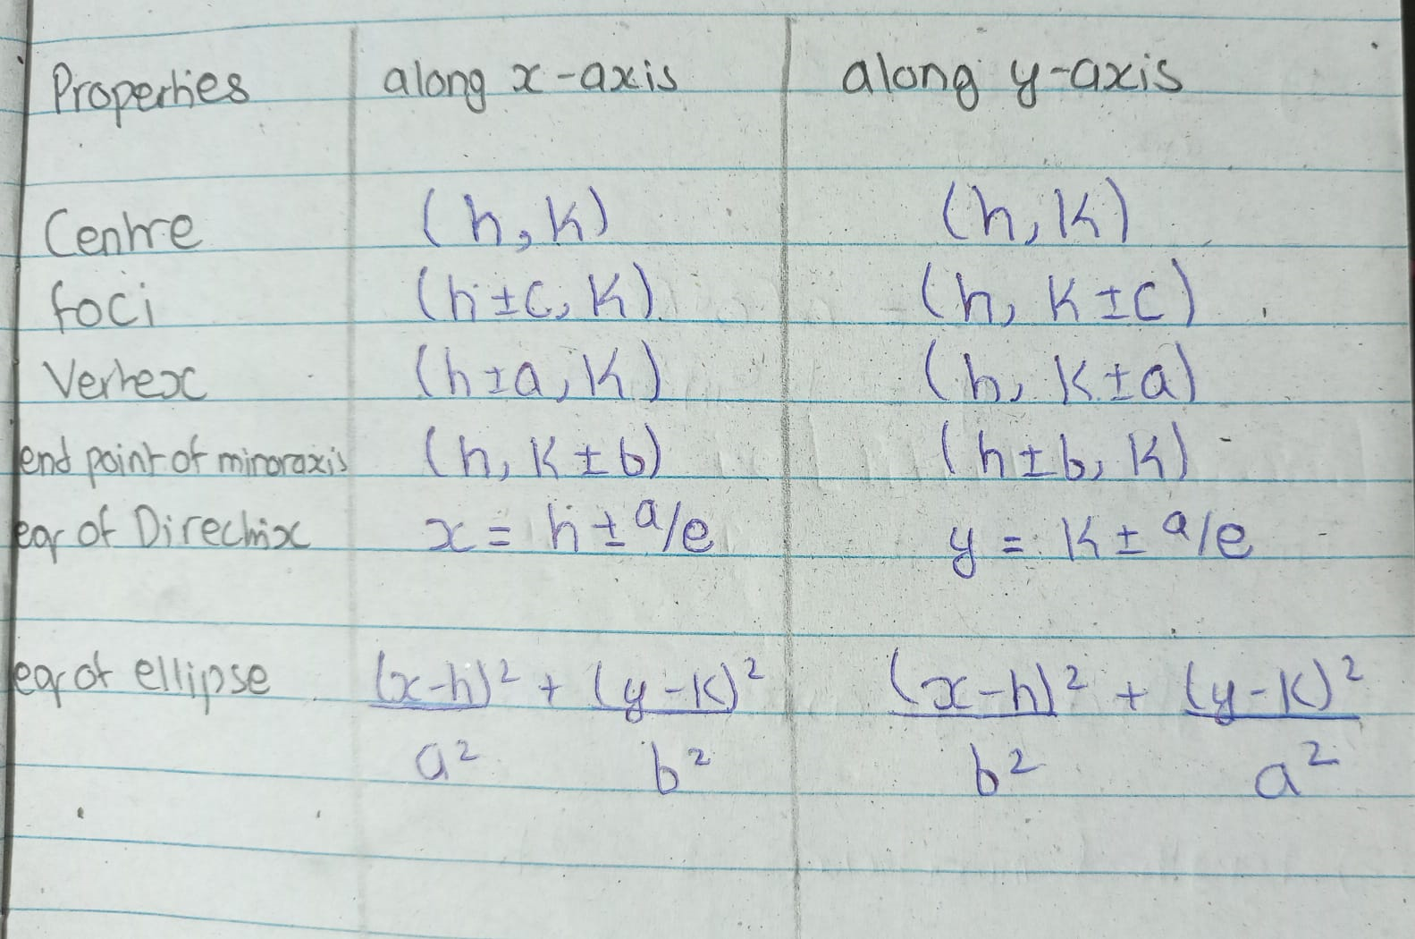
ELLIPSE WHOSE CENTRE NOT AT ORIGIN;

Slide 21
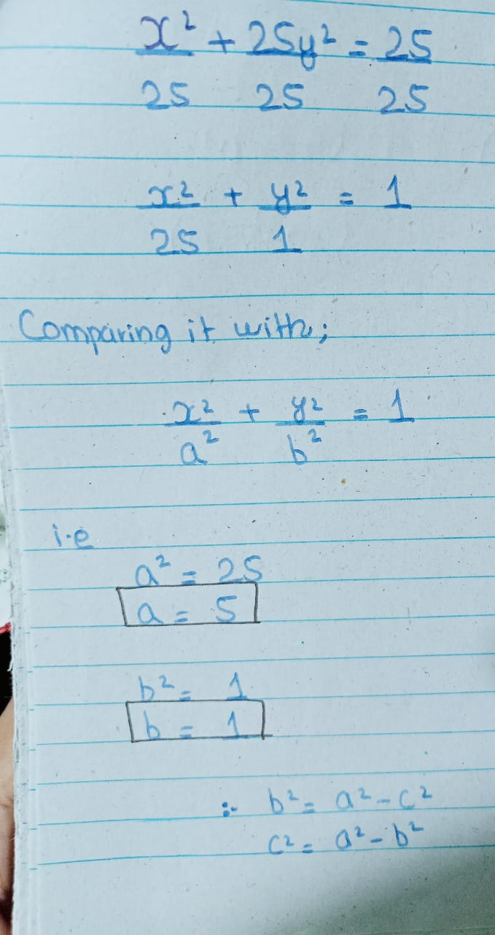
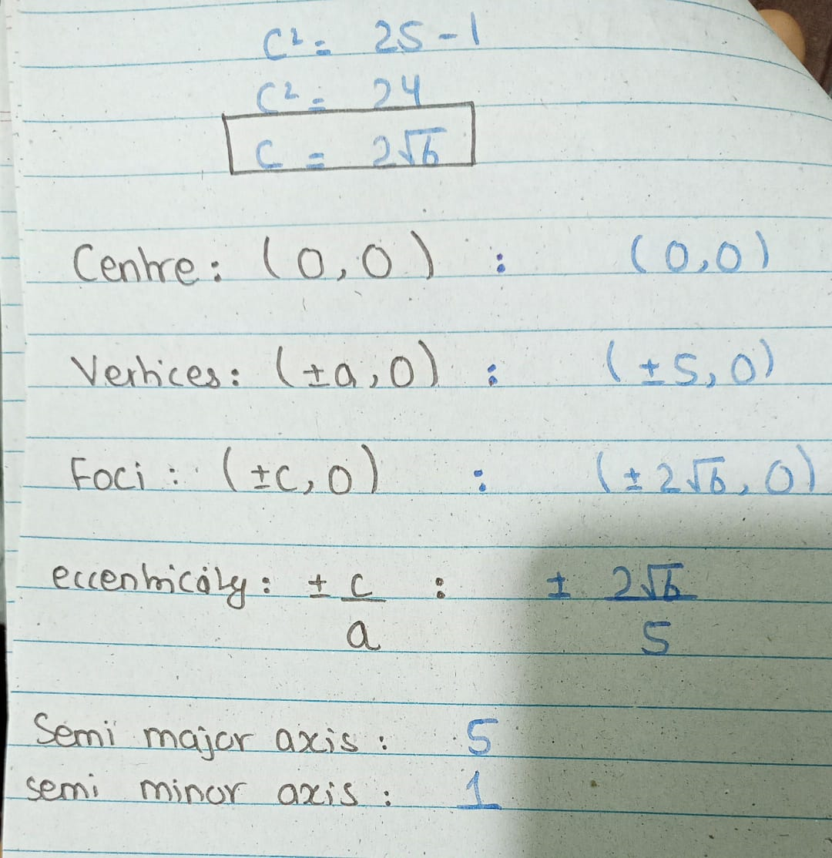
EXAMPLE QUESTION:-
FIND ALL THE PARTS OF THE GIVEN EQUATION.(x^2+25y^2=25)

Slide 22
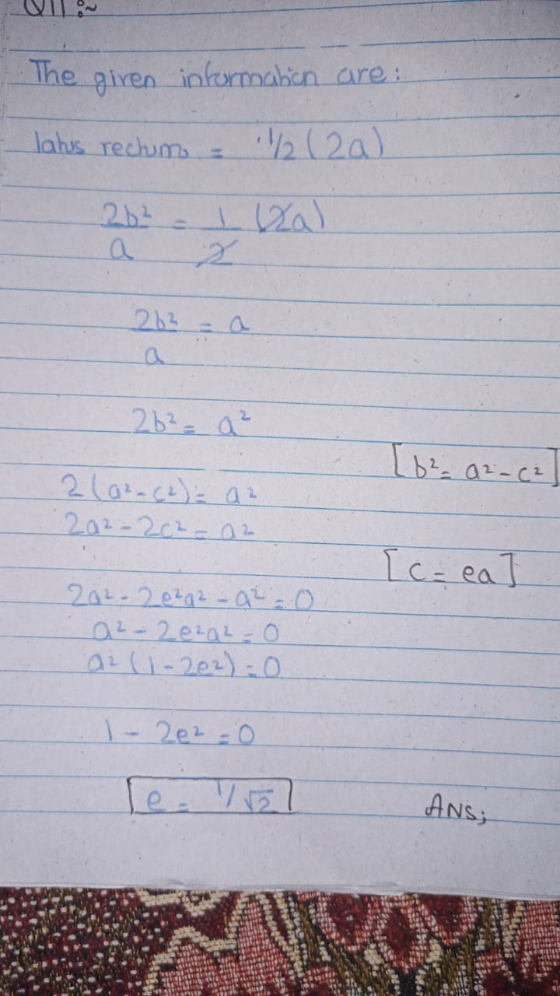
EXAMPLE QUESTION:-
FIND THE ECCENTRICITY OF AN ELLIPSE WHOSE LATUS RECTUM IS EQUAL TO HALF OF ITS MAJOR AXIS.

Slide 23
PRACTICE QUESTIONS:-
QUESTION NO 01:-
FIND THE ECCENTRICITY OF AN ELLIPSE WHOSE LATUS RECTUM IS EQUAL TO HALF OF ITS MAJOR AXIS.
QUESTION NO 02:-
THE LENGTH OF THE MAJOR AXIS OF AN ELLIPSE IS 25 AND ITS FOCI ARE THE POINTS (5,0)(-5,0);FIND THE EQUATION OF THE ELLIPSE.
QUESTION NO 03:-
FIND THE ECCENTRICITY OF THE ELLIPSE WHOSE AXES ARE 12 AND 24.

Slide 24
Hyperbola
Difference b/w two fixed point is known as Hyperbola
Eccentricity = Greater than 1…

Slide 25
Along X Axis:
Center (0,0)
Foci (+c,0), (-c,0)
Vertex (+a,0), (-a,0)
Asymptotes: b/a (x), -b/a (x)
Eq of hyperbola : x^2/a^2 – y^2/b^2 = 1
Along Y Axis:
Center (0,0)
Foci (0,c), (0,-c)
Vertex (0,a), (0,-a)
Asymptotes: a/b (x), -a/b (x)
Eq of hyperbola : y^2/a^2 – x^2/b^2 = 1
As we know that: c^2=a^2+b^2

Slide 26
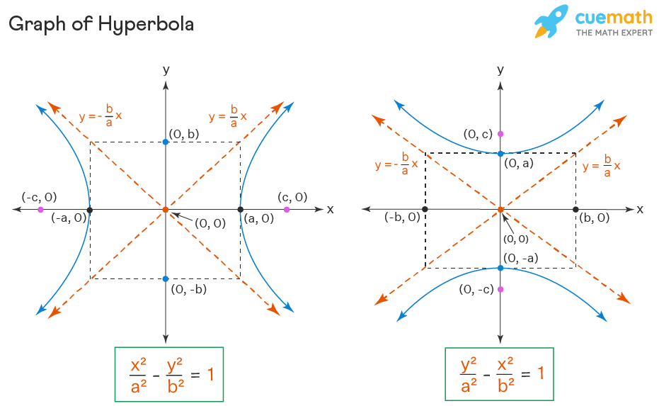
HORIZONTAL HYPERBOLA VERTICAL HYPERBOLA

Slide 27
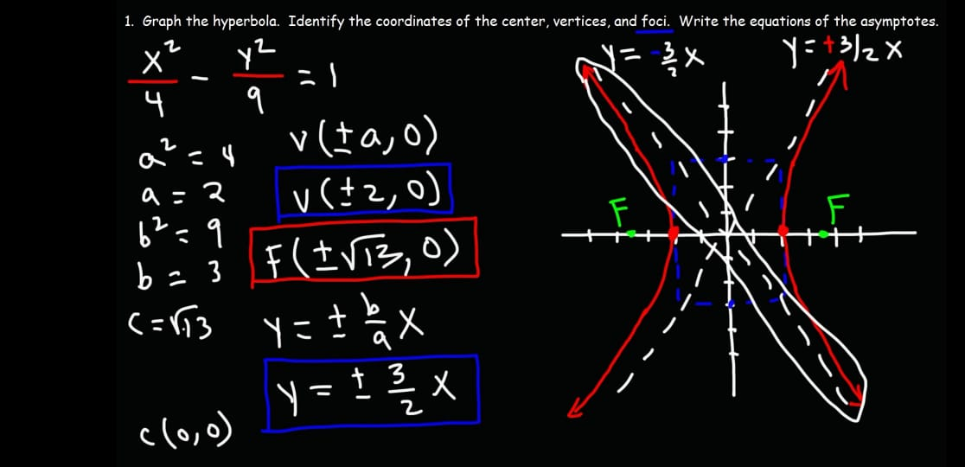

Slide 28
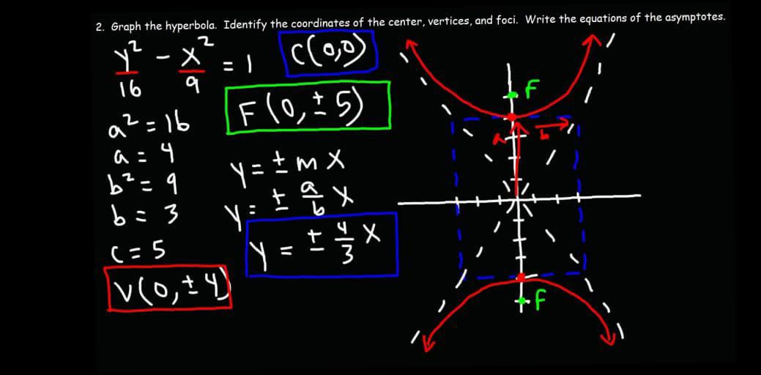

Slide 29
Along x – axis:
Center (h,k)
Foci (h+c,k), (h-c,k)
Vertex (h+a,k), (h-a,k)
Asymptotes: y-k=b/a (x-h), -b/a (x-h)
Eq of hyperbola: (x-h)^2/a^2 – (y-k)^2/b^2 = 1
Along y – axis:
Center (h,k)
Foci (h,k+c), (h,k-c)
Vertex (h,k+a), (h,k-a)
Asymptotes: y-k=a/b (x-h), -a/b (x-h)
Eq of hyperbola: -(x-h)^2/b^2 + (y-k)^2/a^2 = 1
As we know that : c^2=a^2+b^2

Slide 30
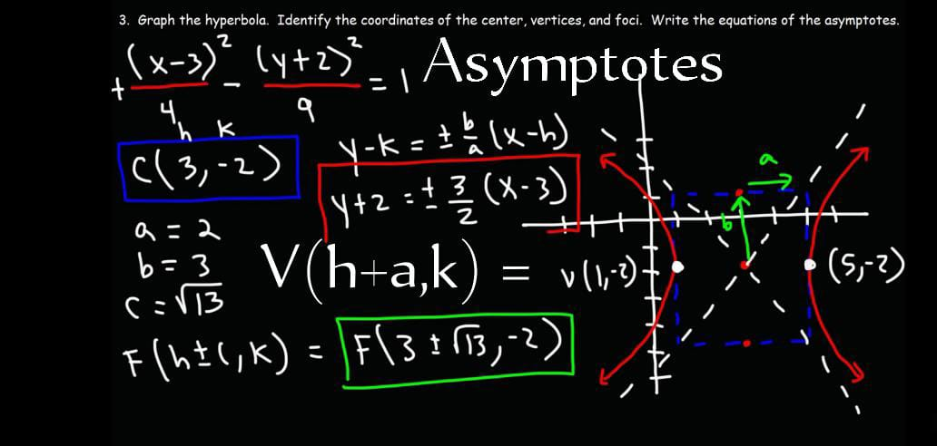

Slide 31
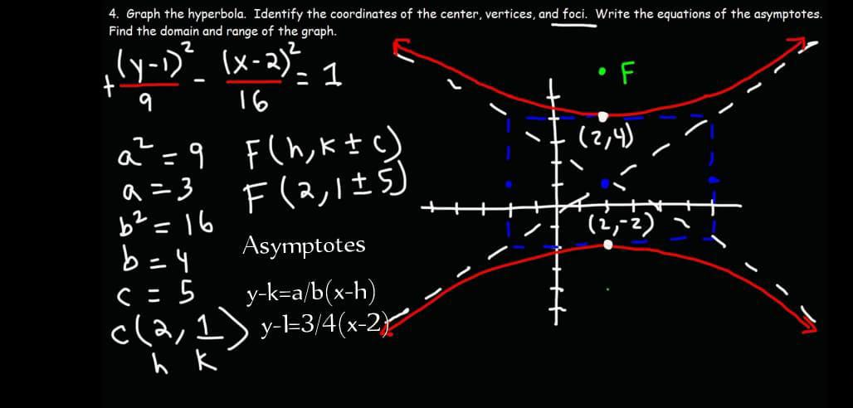

Slide 32
Solve the following questions :
Q1. Find foci, vertices and the following hyperbola.
(x ^ 2)/4 – (y ^ 2)/5 = 1
Q2. Find center, foci, vertices and Asymptotes of the following hyperbola.
(y ^ 2)/4 – (x^2)/5 = 1

Slide 33
CONCLUSION

Slide 34
THANKS FOR YOUR TIME
A more unique conclusion of conic sections and their parts is that they are all closely related to each other. In fact, they can all be generated from a single equation:
Ax^2 + Bxy + Cy^2 + Dx + Ey + F = 0
This equation is called the general conic equation, and it can be used to represent any type of conic section, depending on the values of the coefficients A, B, C, D, E, and F.
Another unique conclusion is that conic sections can be used to model a wide variety of natural phenomena. For example, the orbits of planets and comets are conic sections, as are the paths of light rays through lenses and mirrors. Conic sections are also used in the design of many man-made objects, such as bridges, telescopes, and satellite dishes.
In short, conic sections are a beautiful and powerful tool that can be used to understand and model the world around us.
Here is a more creative conclusion:
Imagine a universe where the laws of physics are different, and conic sections no longer exist. What would happen?
Without conic sections, the orbits of planets and comets would be unpredictable. Light rays would not travel in straight lines. And many of the man-made objects that we rely on every day would not be possible.
In short, our universe would be a very different place without conic sections.
I hope this is more unique and interesting conclusion for you.
THANKS YOU ALL

